Slide 1
Lecture 16
Nick Rugai PhD
Stetson University

Slide 2
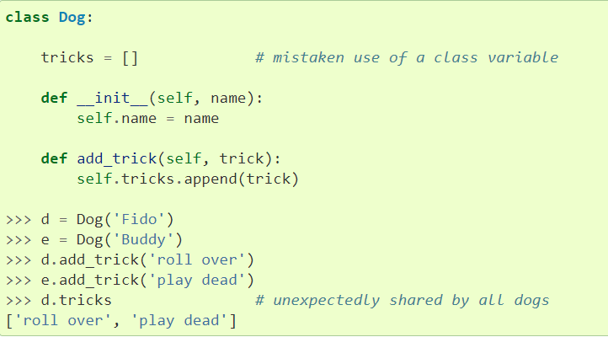
Classes Ch 16
Due to the inherit ‘shareness’ of OOL,
mutable objects such as lists and dictionaries are shared!!! Be careful!

Slide 3
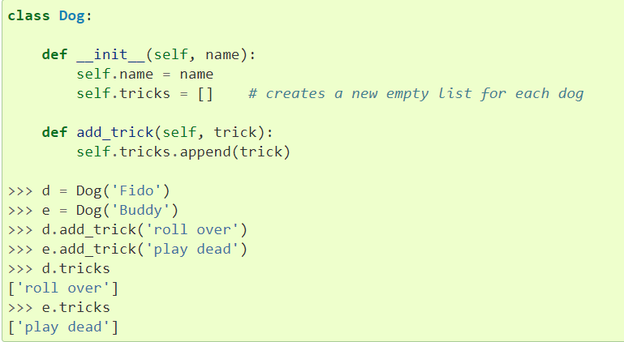
Classes
This is the correct way of using a list within a class using functions as ‘protection’.

Slide 4
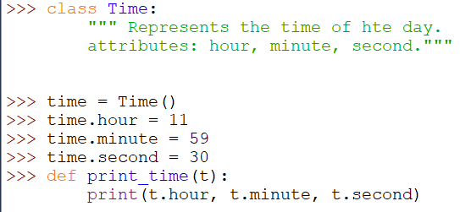
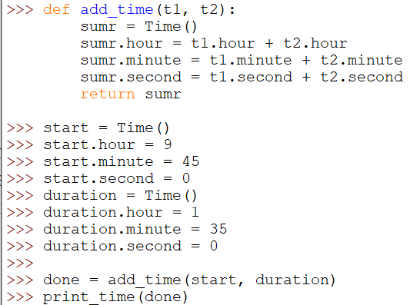
Classes
The triple quotes allow to comment out more than one line.

Slide 5
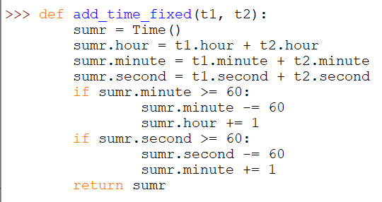
Classes
We need to fix the issue that there are only 60 minutes and seconds.
These are examples of PURE FUNCTIONS.
They DO NOT modify any of the objects passes as arguments.

Slide 6
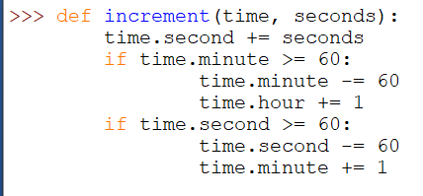
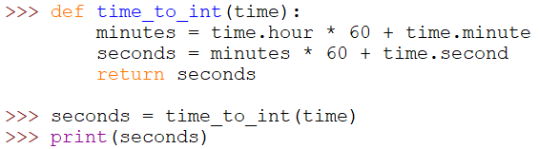
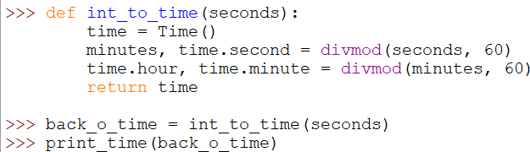
Classes
This function is a MODIFIER. Be careful!!!
Functional Programming: Always write a pure function unless there is a compelling reason to use a modifier!

Slide 7

Classes
Elegant way of add time.
Because there is no negative time and no more than 60 minutes and seconds, it is wise to check for INVARIANTS.

Slide 8
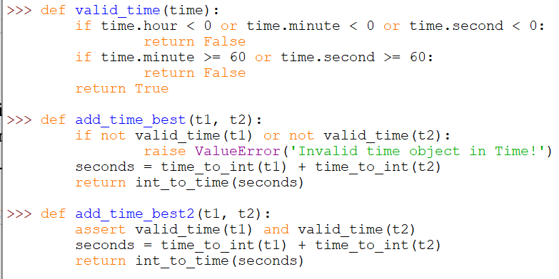
Classes
Because there is no negative time and no more than 60 minutes and seconds, it is wise to check for INVARIANTS.

